Slide 1
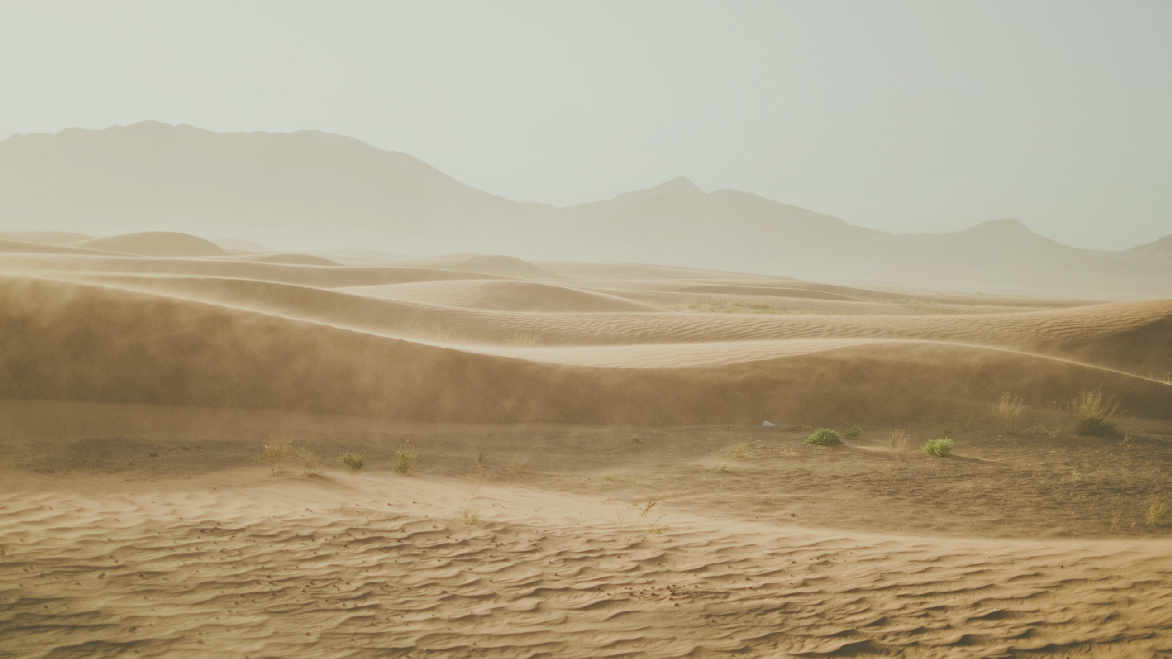

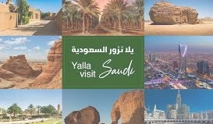
Kingdom of Saudi Arabia Ministry of Education University of Tabuk
Applied College Programming and Computer Science
Tourist Guide website in the Saudi Arabia
List Name of students and Academic numbers
Nada Murayhil Albalawi 441008330
Nashwa Eid Al-Juhani 441006700
Abeer Suleiman Al-Atwi 441004545
Reem Salem Al-Qarni 441007012
Name of the supervisor
Rasha Albalawi

Slide 2
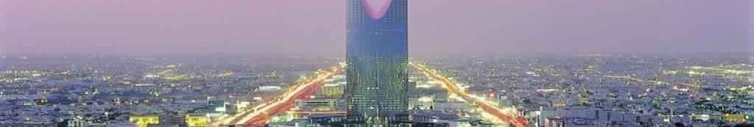
Since Saudi Arabia has now become a tourist destination, we have tourists from different regions, and there must be a platform that introduces them to hotels, restaurants, and shopping to move on one platform instead of searching the Internet for incorrect information and distracting them.The Tourist Guide website aims to provide comprehensive and helpful information to tourists during their trips to Saudi Arabia. It makes it easier for tourists to guide them to tourist places.
Introduction

Slide 3


Motivation
Achieve the goals of Vision 2030 which aims to diversify the Saudi economy, strengthen tourism as a key sector for growth and development, and improve cultural.

Slide 4
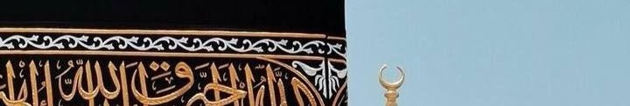
The lack of unified website that provide a tourist guide and there is no support the
tourism sector that include all the places that a . tourist can go to
Problem
statement

Slide 5
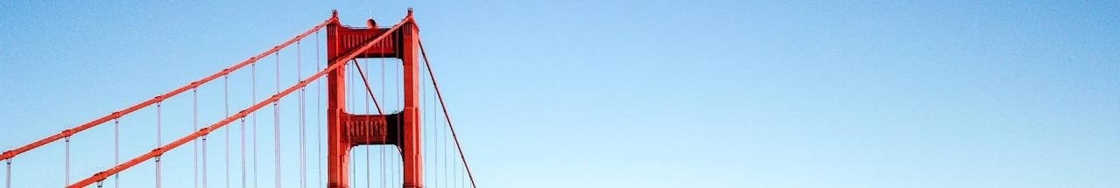
The website will provide Information on tourist attractions which have description of the main cultural tourist attractions with historical and information.
The website will provide Guide to Restaurants and Cafes which provides information about a variety of food options including local specialties.
The website will provide Shopping local to tourists directing information which shopping and places and traditional markets.
Objectives

Slide 6
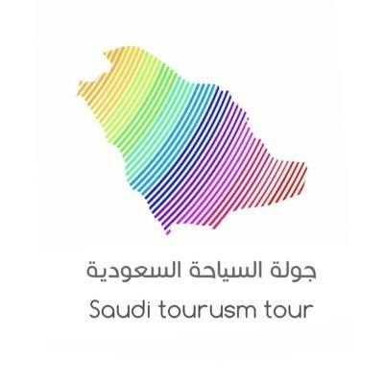
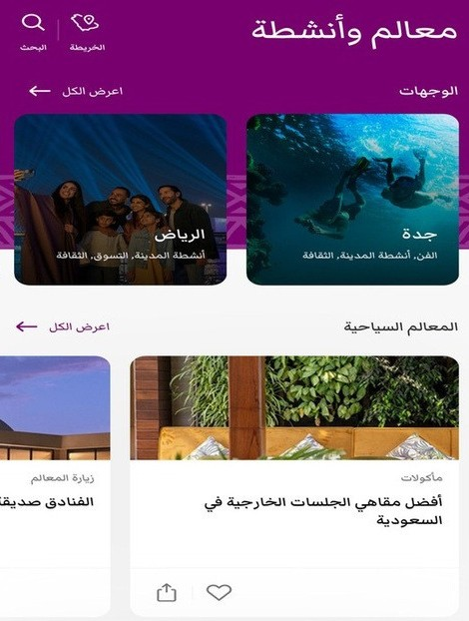
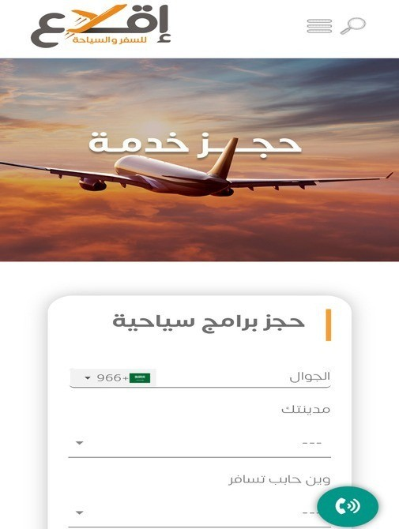

Related work
T h e J a w l a h a p p l i c a t i o n
R o o h S a u d i A r a b i a a p p l i c a t i o n
I q l a a w e b s i t e .

Slide 7
Website design and
languages used
To implement the website, we have followed these steps:
1. At First, we considered a problem facing society, and we found that there is no support for the tourism sector, which includes all the places and landmarks that a tourist can visit.
.2 We have researched cities and hotels and compiled the information we have searched for to help us with our website.
.3 We planned to draw a use case for the site.
.4We identified how to solve the problem in all respects and started with the site's initial design by drawing a prototype.

Slide 8
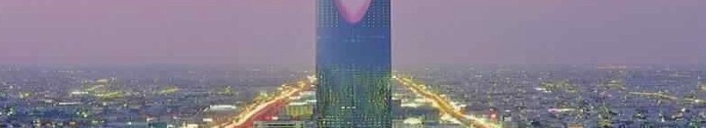
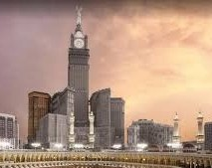
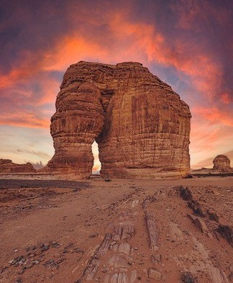
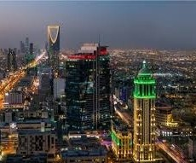
Website design and
languages used
5. We designed the 5-page site using programming languages HTML, CSS, and-Javascript, Cities featured on the website: Makkah, Riyadh, AlUla, Tabuk.
6.Finally, we tested the site to make sure the website works well.

Slide 9
Use case

Slide 10
The result of our work is a site that offers its users the best tourist places in the
Kingdom of Saudi Arabia, whether they are upscale hotels, distinctive cafes, delicious restaurants, or interesting markets. The project's outcomes contribute to the advancement of the tourism industry within the Kingdom, providing a platform that
enhances the tourist experience and promotes the exploration of its diverse cities
Result

Slide 11


Due to the time constraints of the project, we were unable to integrate both Required features
In future work, the site will contain all the tourist cities in the Kingdom of Saudi Arabia In addition, the website will be supported
Limitation and Future Work
Different languages, such as English and other languages To help tourists
Among the advantages
Add photos and videos to illustrate the beauty of places Make the visitor experience reality
Thank…

